Slide 1
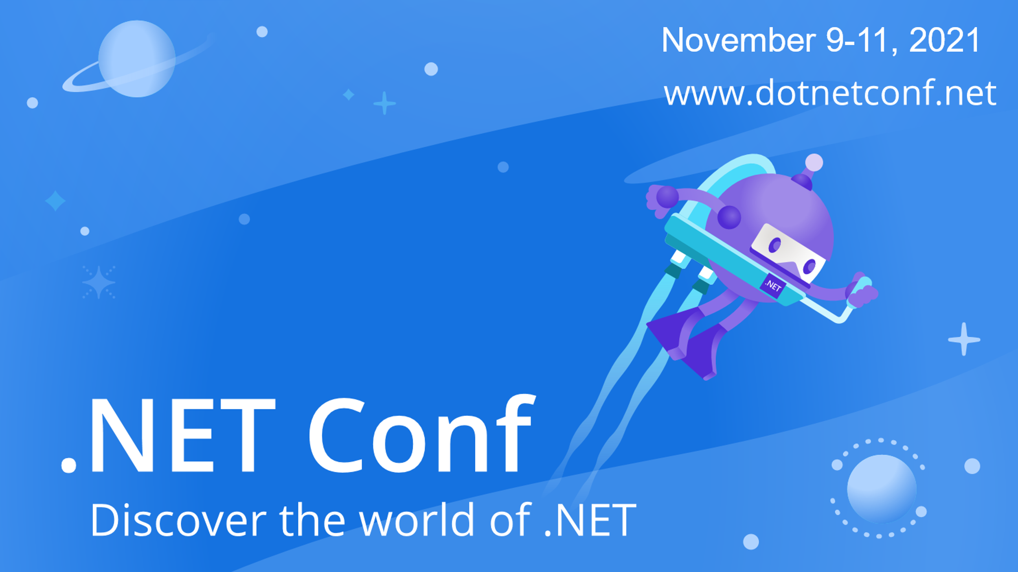

Slide 2


Serverless .NET 6 with Azure Functions
Fabio Cavalcante
@codesapien
Anthony Chu
@nthonyChu

Slide 3

Run code when events occur
Event-driven scaling
No infrastructure management
Consumption pricing with free grant
Azure Functions
Notes:
Quick overview of Azure Functions

Slide 4
Recent updates
Availability zones
OpenAPI extension (preview)
New Durable Functions backends (preview)

Slide 5
GENERALLY AVAILABLE
Updates to popular extensions
Blobs, Queues, Event Hubs, Event Grid, Service Bus
Supports identity-based connections
New extension: Azure Web PubSub
.NET 6 support in Azure Functions 🎉

Slide 6
Azure Functions .NET Roadmap
In-process
.NET Core 3.1 ^{LTS}

Slide 7
Azure Functions .NET Roadmap
.NET 5
Isolated process
In-process
.NET Core 3.1 ^{LTS}

Slide 8
Azure Functions .NET Roadmap
.NET 5
.NET 6 ^{LTS}
Isolated process
.NET Conf 2021
In-process
.NET Core 3.1 ^{LTS}
.NET 6 ^{LTS}

Slide 9
Azure Functions .NET Roadmap
.NET 5
.NET 6 ^{LTS}
.NET 7
.NET 8 ^{LTS}
Isolated process
2022
2023
In-process
.NET Core 3.1 ^{LTS}
.NET 6 ^{LTS}

Slide 10
Azure Functions .NET Roadmap
.NET 5
.NET 6 ^{LTS}
.NET 7
.NET 8 ^{LTS}
Isolated process
2022
2023
In-process
.NET Core 3.1 ^{LTS}
.NET 6 ^{LTS}

Slide 11
Which one do I use?
In-process
Isolated process
Migrate from .NET Core 3.1 in-process
Need Durable Functions or “rich” SDK type bindings
Migrate from .NET 5 isolated process
Durable Functions coming to isolated process in 2022

Slide 12

Demo

Slide 13
Demo:
File new project, hello world, highlight that VS 2022 is using Azurite
Show something with identity-based connections
Show app running in Azure and point out how managed identity works

Slide 14

aka.ms/Functions-V4-GA-Blog
Notes:
Call to action

Slide 15
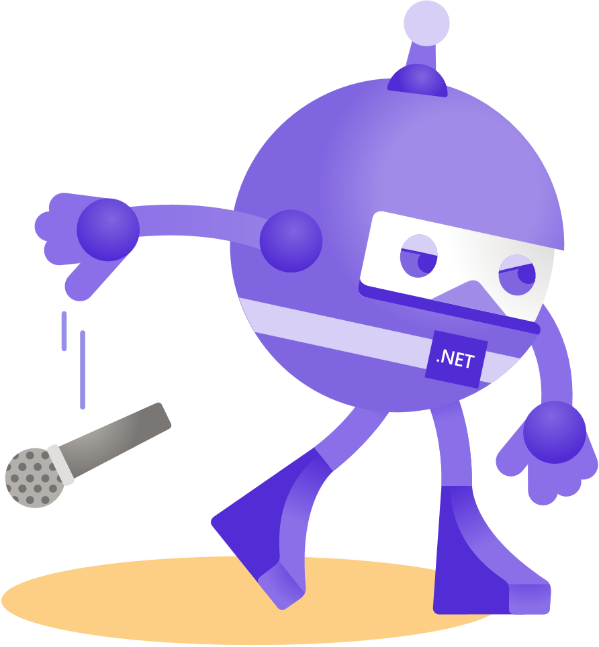
Thanks for joining!

Slide 16
Azure Functions .NET Roadmap
.NET 5
.NET 6 ^{LTS}
.NET 7
.NET 8 ^{LTS}
Isolated process
Nov 2021
In-process
.NET Core 3.1 ^{LTS}
.NET 6 ^{LTS}
with Durable Functions

Slide 17









Slide 18
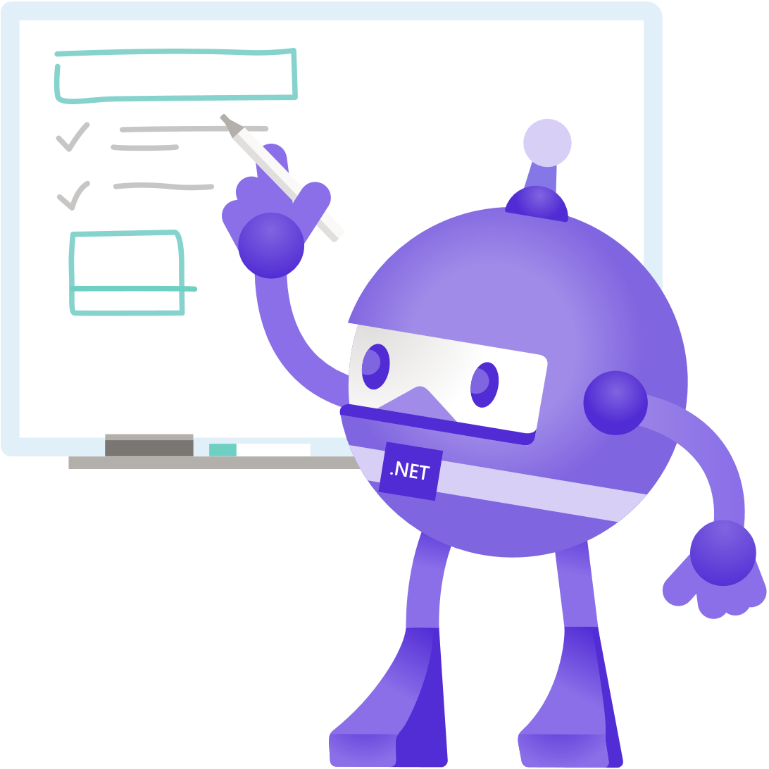







Slide 19


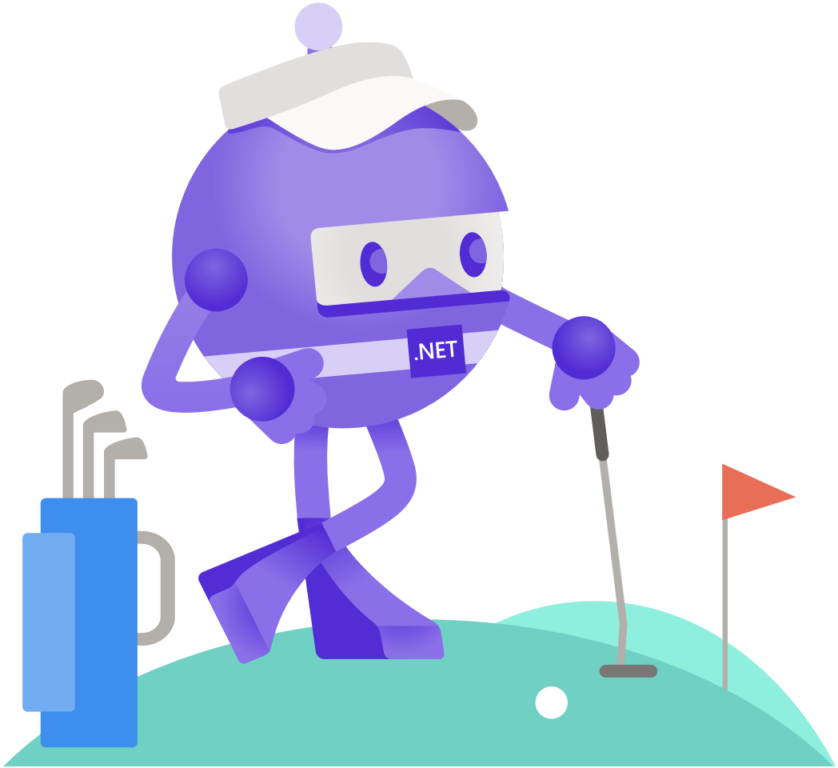





Slide 20


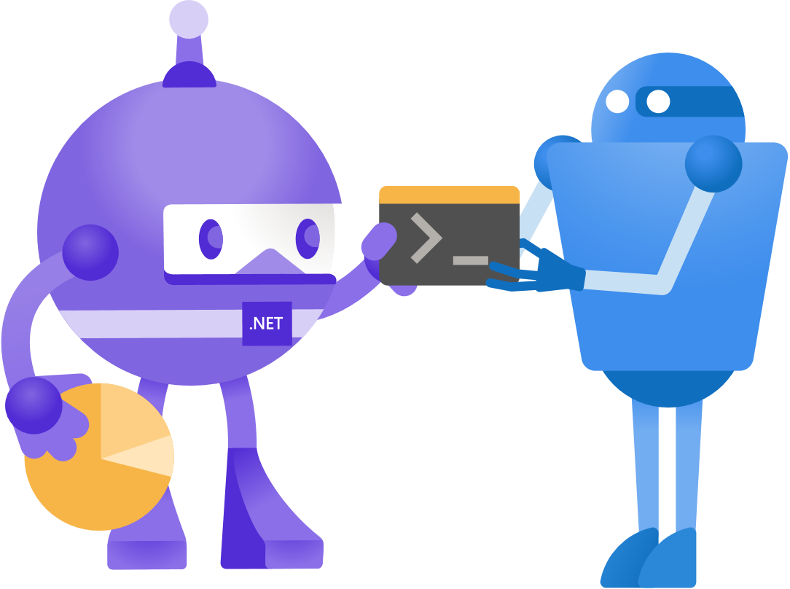

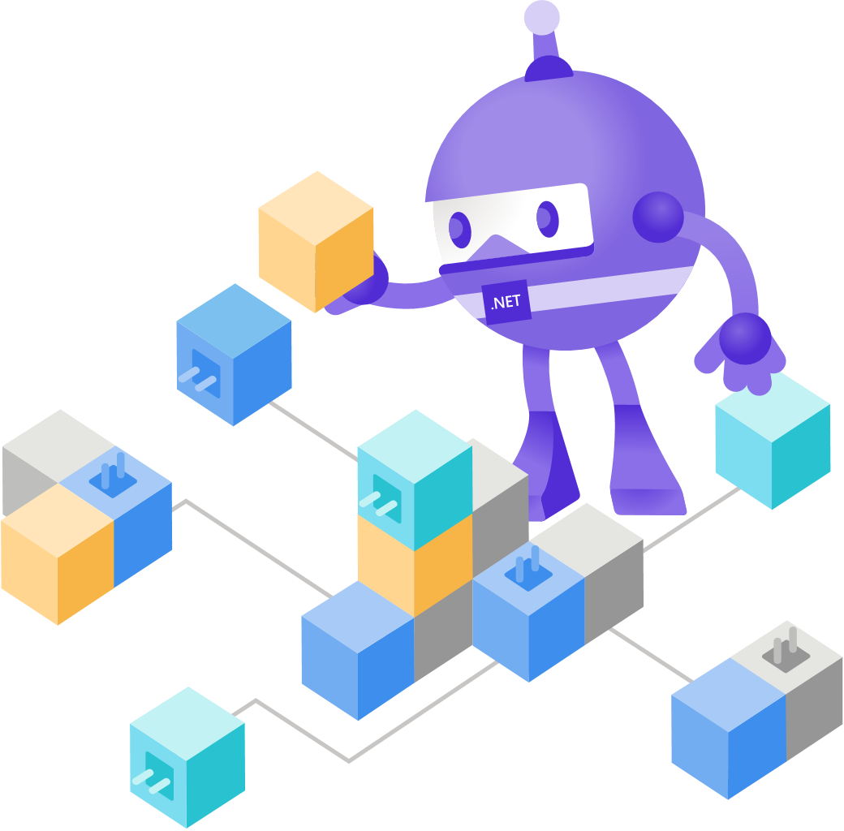
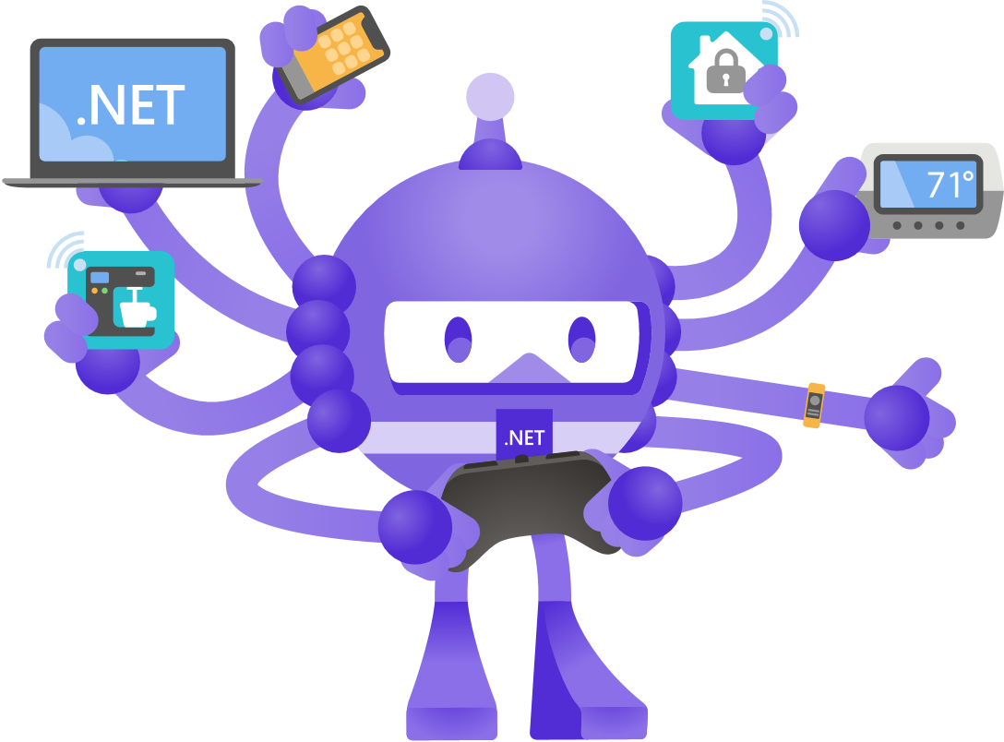

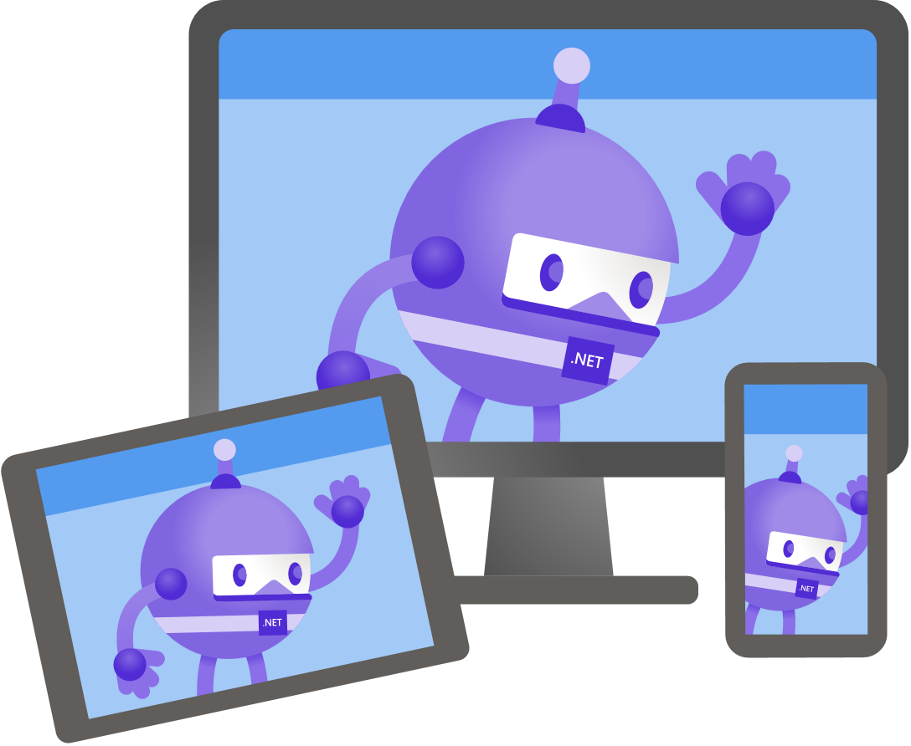

Slide 21





Slide 22


Slide 23


Slide 26


